Slide 1
ESS Selenium Configuration
2012.07.11
Shelly Huang, ESS Shanghai

Slide 2
Topics
Pre-condition
Fire fox Configuration
Eclipse Configuration
Sample Test Case Execution

Slide 3
Pre-condition

Slide 4
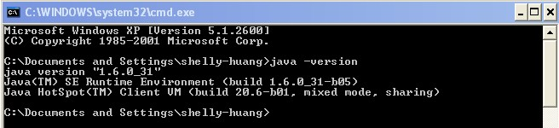
Pre- condition
- Check Java version
Command window： java –version
Note: java version should be 1.5 or above

Slide 5
Pre- condition
- Install Eclipse
Copy Eclipse to your local, unzip and install
\\cnshn13db04v\Share_SDC\ESS_Automation_Framwork\SeleniumRampup\Demo\Java-RC\Installation
File\eclipse-SDK-3.7.2-win32.zip
- Install Fire fox
Copy Fire fox to your local, install
\\cnshn13db04v\Share_SDC\ESS_Automation_Framwork\SeleniumRampup\Demo\Java-RC\Installation File\Firefox Setup 6.0.2.exe

Slide 6
Pre- condition
- Copy Selenium jars to your local
\\cnshn13db04v\Share_SDC\ESS_Automation_Framwork\SeleniumRampup\Demo\Java-RC\JAR_DLL\selenium-java-2.20.0.jar
\\cnshn13db04v\Share_SDC\ESS_Automation_Framwork\SeleniumRampup\Demo\Java-RC\JAR_DLL\selenium-server-standalone-2.20.0.jar
\\cnshn13db04v\Share_SDC\ESS_Automation_Framwork\SeleniumRampup\Demo\Java-RC\JAR_DLL\javacsv.jar
\\cnshn13db04v\Share_SDC\ESS_Automation_Framwork\SeleniumRampup\Demo\Java-RC\JAR_DLL\jxl.jar_x000b_
Note: Only selenium-java-2.20.0.jar and selenium-server-standalone-2.20.0.jar are selenium related jars. javacsv.jar and jxl.jar will be referenced in the later sample test case scripts. Just list here for convenience and will be added into library get along as selenium jars at one time.

Slide 7
Pre- condition
- Copy Selenium IDE, Firebug and XPath to your local
\\cnshn13db04v\Share_SDC\ESS_Automation_Framwork\SeleniumRampup\Demo\Java-RC\Fire fox Add-ons\firebug-1.9.2-fx.xpi
\\cnshn13db04v\Share_SDC\ESS_Automation_Framwork\SeleniumRampup\Demo\Java-RC\Fire fox Add-ons\selenium-ide-1.7.2.xpi
\\cnshn13db04v\Share_SDC\ESS_Automation_Framwork\SeleniumRampup\Demo\Java-RC\Fire fox Add-ons\xpath_checker-0.4.4-fx.xpi

Slide 8

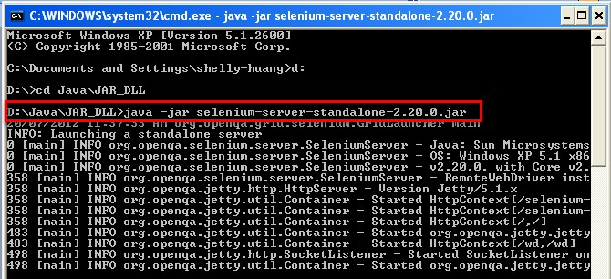
Pre- condition
- Test selenium server
Copy .bat file to your local, modify path to your local path, Double click to run
\\cnshn13db04v\Share_SDC\ESS_Automation_Framwork\SeleniumRampup\Demo\Java-RC\StartSeleniumServer.bat
Note: You can also start server from command line.

Slide 9
Fire fox Configuration

Slide 10
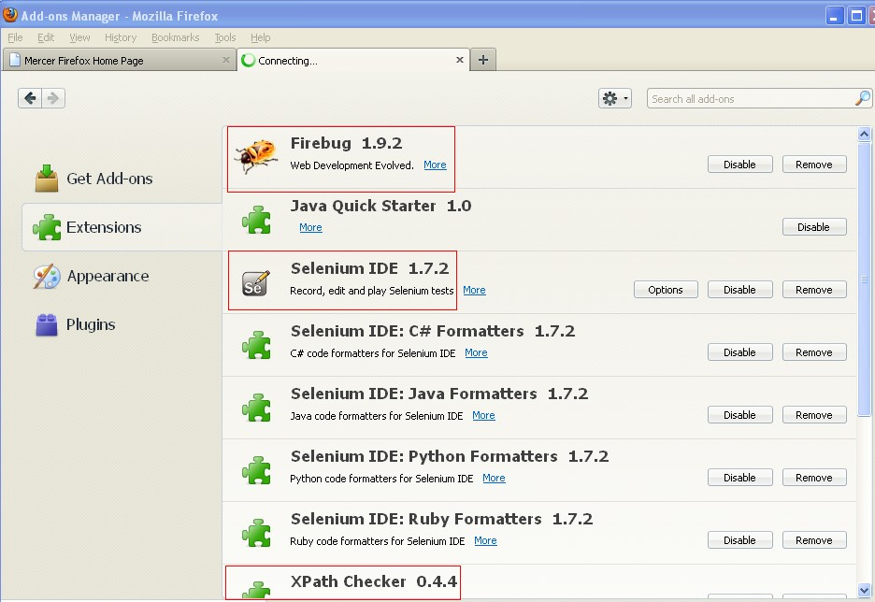
Fire fox Configuration
1. Open Fire Fox
2. Tools->Add-Ons->Extensions
3. Pull below files into Extensions page
- selenium-ide-1.7.2.xpi
- firebug-1.9.2-fx.xpi
- xpath_checker-0.4.4-fx.xpi

Slide 11
Eclipse Configuration

Slide 12
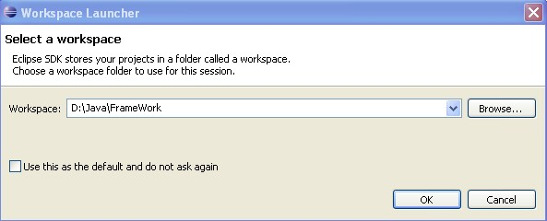

Eclipse Configuration
1. Launch Eclipse, Specify workspace
2. Click Ok
3. Select File > New > Java Project.

Slide 13
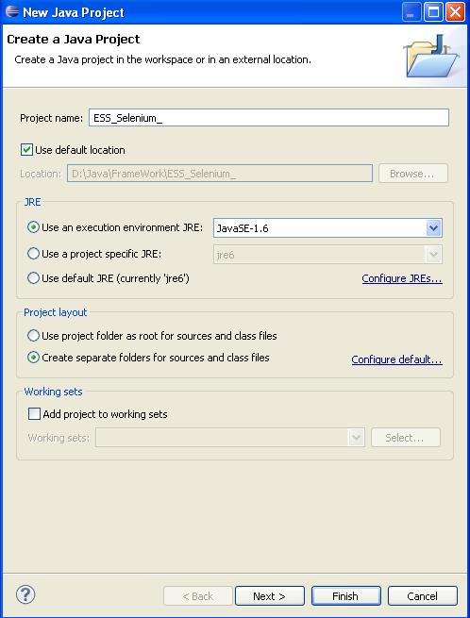
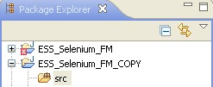
Eclipse Configuration
4. Type in Project Name, click Finish

Slide 14
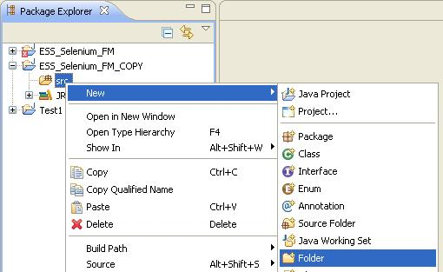
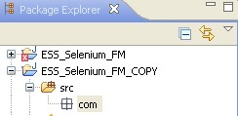
Eclipse Configuration
5. Right Click on src folder and click on New- >Folder
6. Name this folder as com and click on Finish

Slide 15

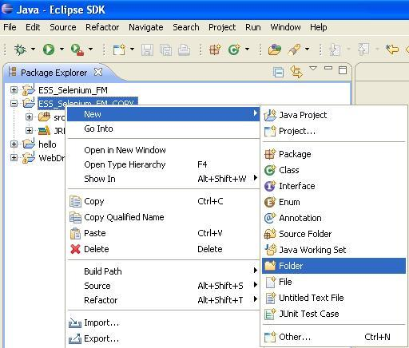
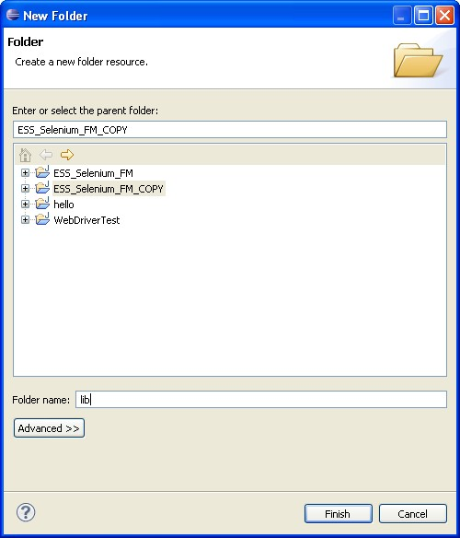
Eclipse Configuration
7. Right Click on com folder and click on New- >Folder
8. Name this folder as testscripts and click on Finish button
9. Create a folder called lib inside project. Right click on Project name -> New -> Folder

Slide 16
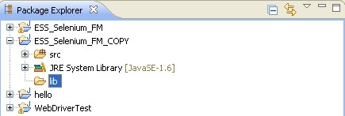
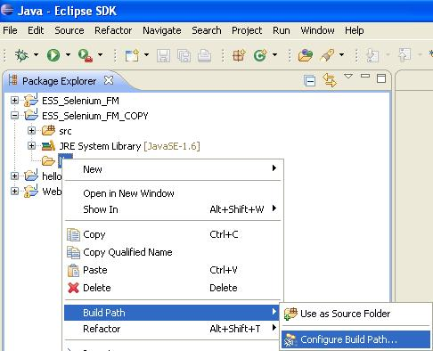
Eclipse Configuration
10. Click Finish
11. Right click on lib > Build Path > Configure build Path

Slide 17
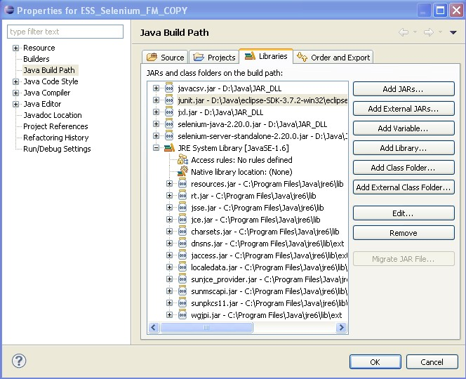
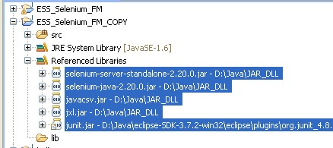
Eclipse Configuration
12.Under Libraries tab click on Add External Jars to navigate to directory where jar files are saved. Select the jar files which are to be added and click on Open button.
Add below Jar
- javacsv.jar
- jxl.jar
- selenium-java-2.20.0.jar
- selenium-server-standalone-2.20.0.jar
- junit.jar (eclipse\plugins\org.junit_4.8.2.v4_8_2_v20110321-1705)
Note: system will prompt to add junit.jar automatically when create a new JUnit test case if not add here.

Slide 18
Sample Test Case Execution

Slide 19
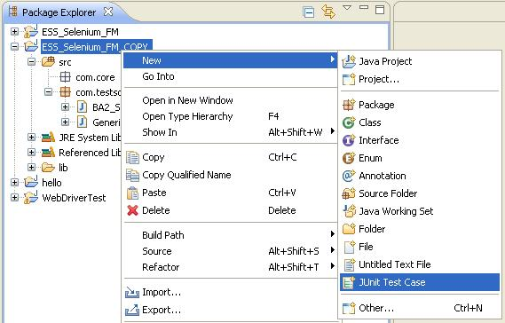
Sample Test Case Execution
1. Create a new JUnit test case. Right click on project name >
New >JUnit test case

Slide 20
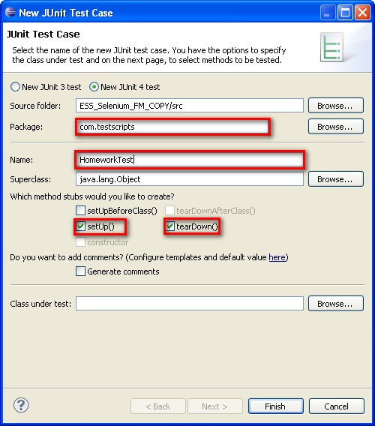
Sample Test Case Execution
Select Package com.testscripts from Browser; Enter Name; select setUp() and tearDown() and then click on Finish button

Slide 21
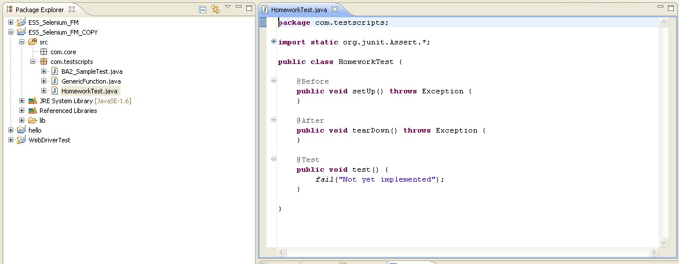
Sample Test Case Execution
JUnit Test case HomeworkTest.java is created

Slide 22
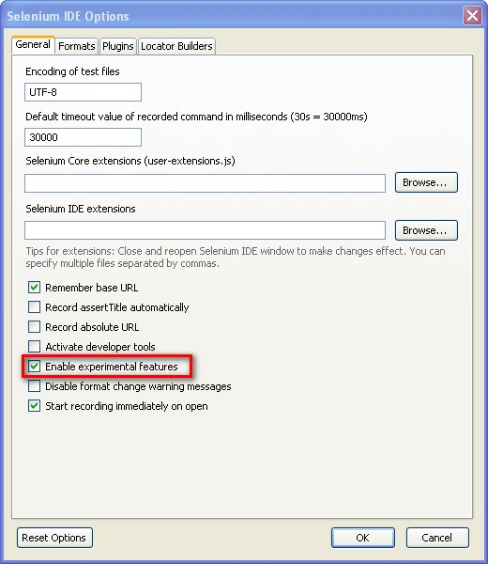
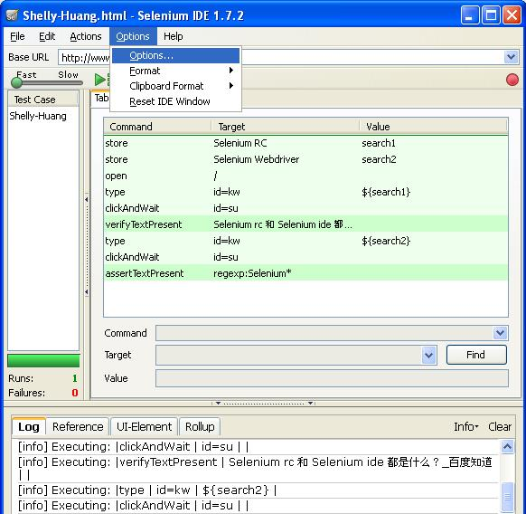
Sample Test Case Execution
2. Convert HTML to java file
Selenium IDE > Options > Options, select Enable experimental features and click on OK
button

Slide 23
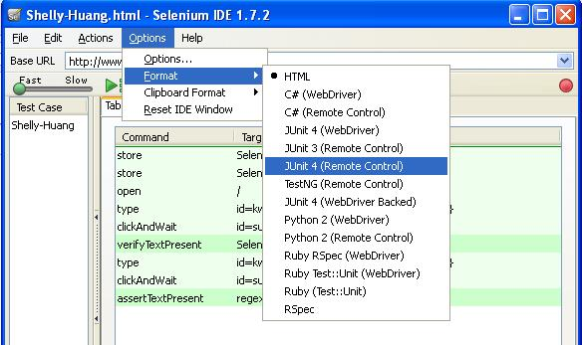
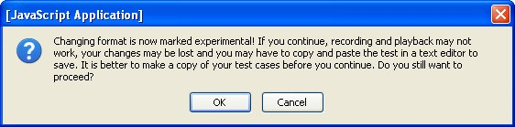
Sample Test Case Execution
Options > Format >JUnit 4( Remote Control)
Click on OK

Slide 24
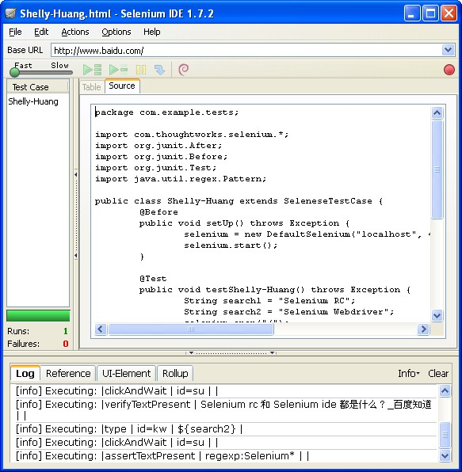
Sample Test Case Execution
HTML is converted to JUnit 4 ( Remote Control ) file

Slide 25
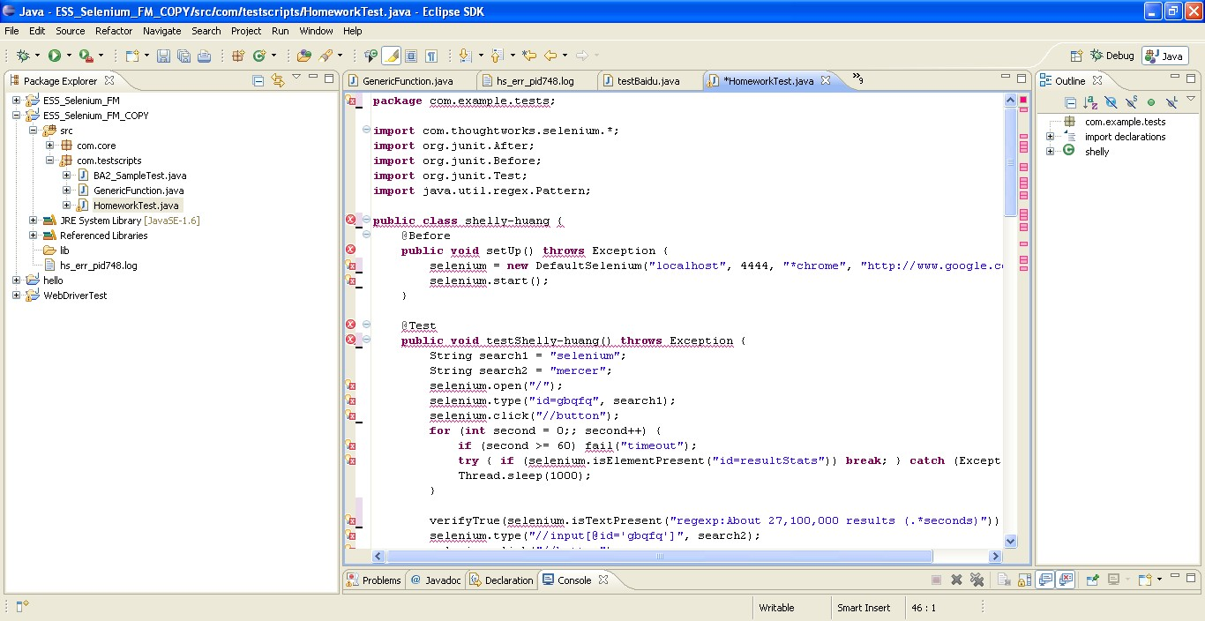
Sample Test Case Execution
3. Modify script
Copy java source file from IDE to Eclipse to overwrite JUnit test case.
Before modify:
There’re many errors. We need to do modification to remove errors

Slide 26
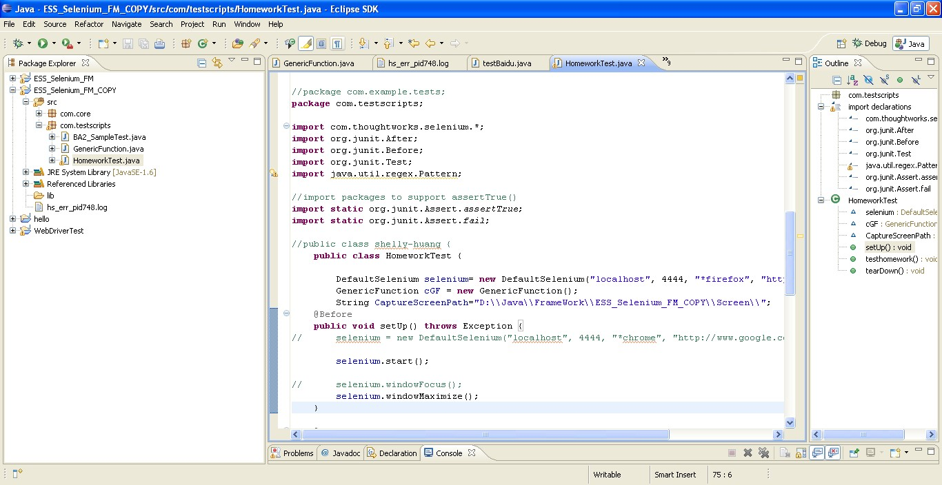
Sample Test Case Execution
After modify:

Slide 27
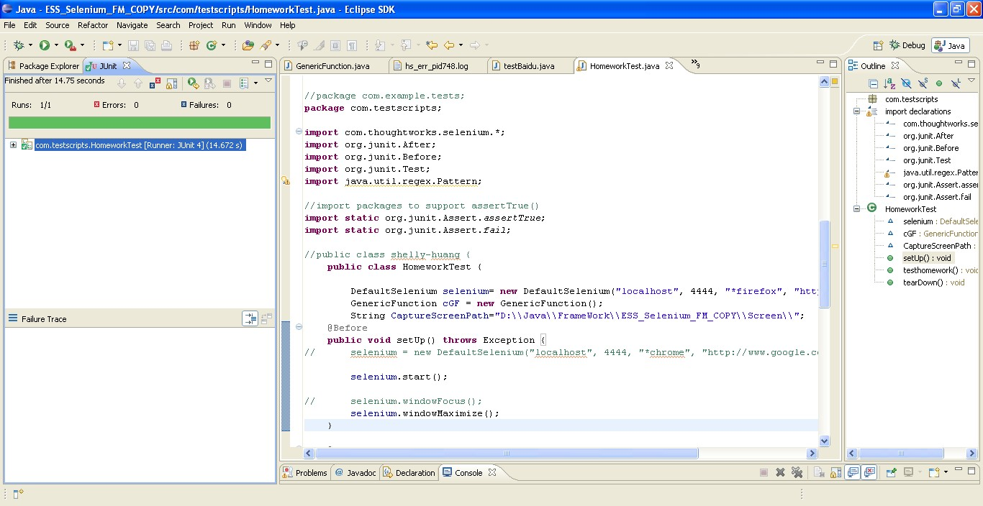
Sample Test Case Execution
4. Double click StartSeleniumSever.bat to start the selenium server
5. Right on HomeworkTest, select Run As – JUnit Test
6. Run pass

Slide 28

www.mercer.com.au

